Slide 1
Trees

Slide 2
Outline
Tree Definition
Binary Trees and Traversals
Binary Tree Operations and Applications
Threaded Binary Trees
Heaps
Different Types of Trees
Binary Search Trees
Selection (Winner/Loser)Trees
Forests

Slide 3
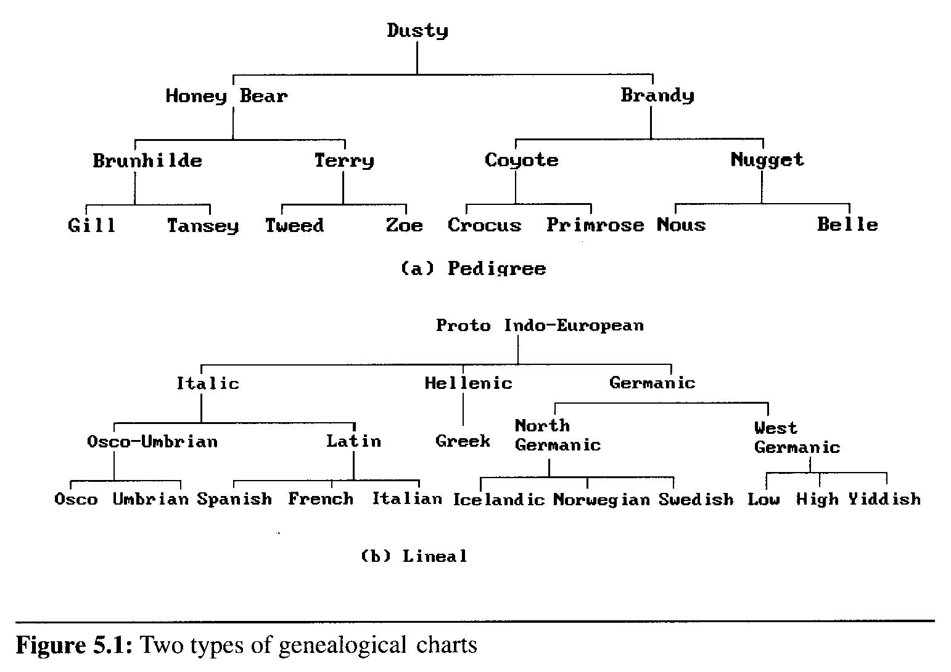
What is a Tree Structure?
A tree structure data are organized by branches
Examples:

Slide 4
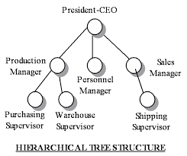
What is a Tree Structure?
Example:

Slide 5
Formal Definition of Trees
Definition: A tree is a finite set of one or more nodes such that
There is a specially designated node: the root node
The remaining nodes are partitioned into n>=0 disjoint sets T₁,…,T_{n} such that each T_{i} is a tree
T₁,…,T_{n} are called the subtrees of the root
Every node in the tree is the root of some subtree

Slide 6
Terminology Definitions (1)
node: the item of information plus the branches to some other nodes
terminal nodes (or leaf): nodes that have degree zero
nonterminal nodes: nodes that don’t belong to terminal nodes
A
B
C
H
D
E
F
G
I

Slide 7
Terminology Definitions (1)
children: the roots of the subtrees of a node X are the children of X
parent: X is the parent of its children
degree: the number of subtrees of a node
degree of a tree: the maximum of the degree of the nodes in the tree
A
B
C
H
D
E
F
G
I

Slide 8
Terminology Definitions (2)
siblings: children of the same parent are said to be siblings.
Ancestors of a node: all the nodes along the path from the root to that node.
The level of a node: Letting the root be at level one. If a node is at level i, then its children are at level i+1.
Height (or depth): the maximum level of any node in the tree
A
B
C
H
D
E
F
G
I

Slide 9
Practice Time
A is the root node
B is the parent of D and E
C is the sibling of B
D and E are the children of B
D, E, F, G, I are external nodes, or leaves
A, B, C, H are internal nodes
Level
A
1
B
C
2
H
3
D
E
F
G
I
4

Slide 10
Practice Time
The level of E is 3
The height (depth) of the tree is 4
The degree of node B is 2
The degree of the tree is 3
The ancestors of node I is A, C, H
The descendants of node C is F, G, H, I
Level
A
1
B
C
2
H
3
D
E
F
G
I
4
(# edges) = (#nodes) - 1

Slide 11
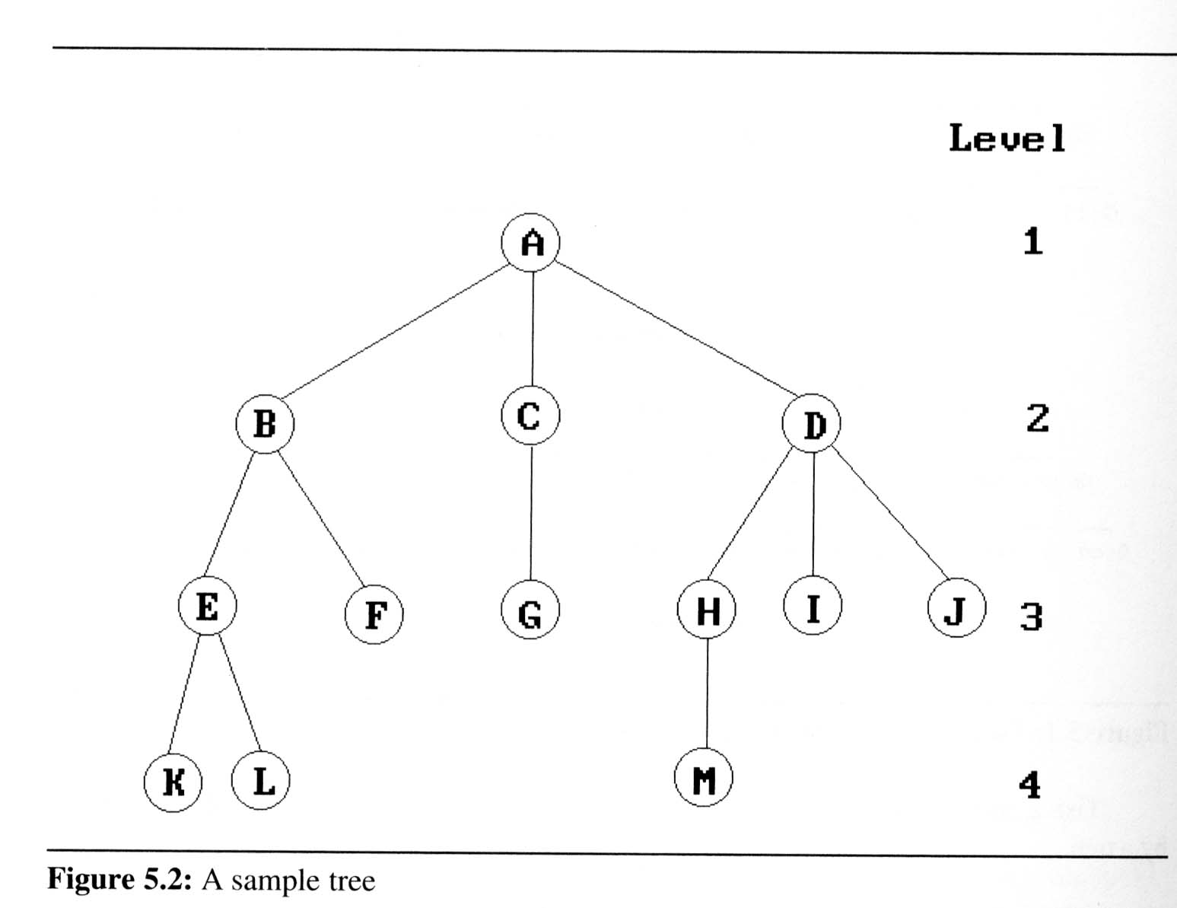
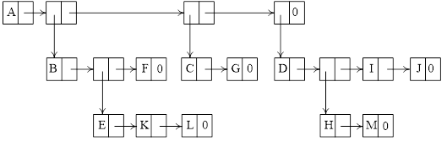
Tree Representations
Graph Representation
List Representation
Each subtree is a sublist
e.g. (A (B (E (K)(L)) (F)) (C (G)) (D (H (M)) (I) (J)))

Slide 12
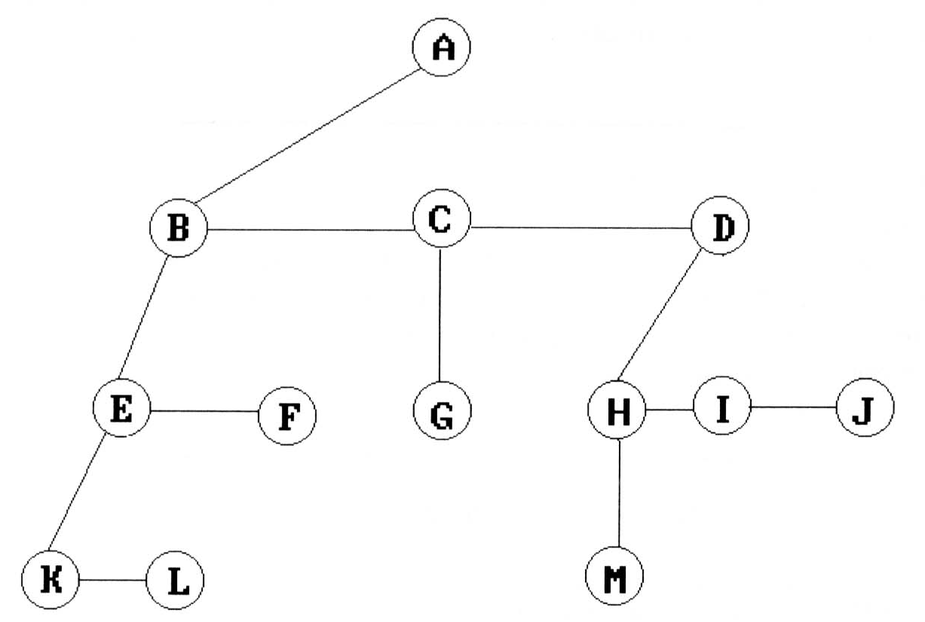
Fixed-Node-Size Representation
Fixed-Node-Size: must have fix number of branches
Left Child-Right Sibling Representation
A binary tree

Slide 13
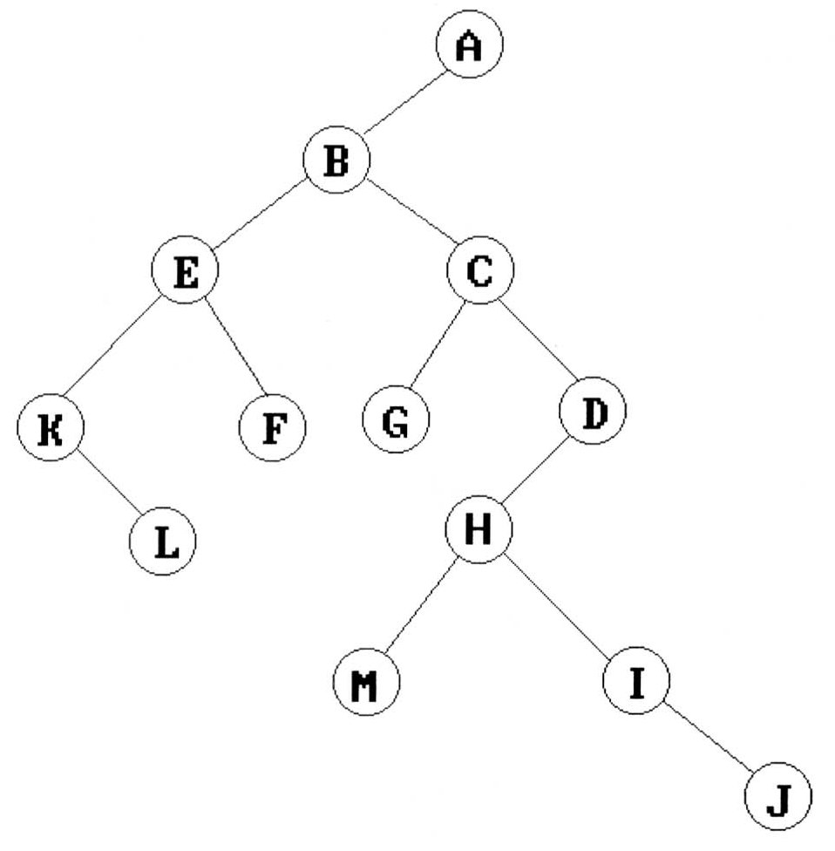
Fixed-Node-Size Representations
Left Child-Right Sibling tree representation
a binary tree

Slide 14
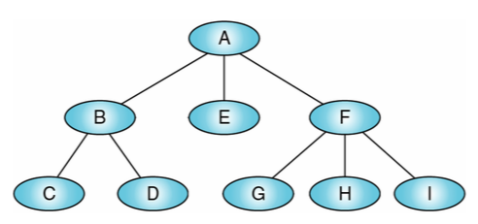
Practice Time
Please show the Left Child-Right Sibling tree representation for the following tree
Any tree can be transformed into binary tree by left child-right sibling representation

Slide 15
Binary Trees
ADT, Properties, Representations

Slide 16
Binary Trees Definition
Binary trees
any node can have at most two branches
Definition (recursive):
A binary tree is a finite set of nodes
empty or
consists of a root and up to two disjoint binary trees
called the left subtree and the right subtree
A
A
B
C

Slide 17
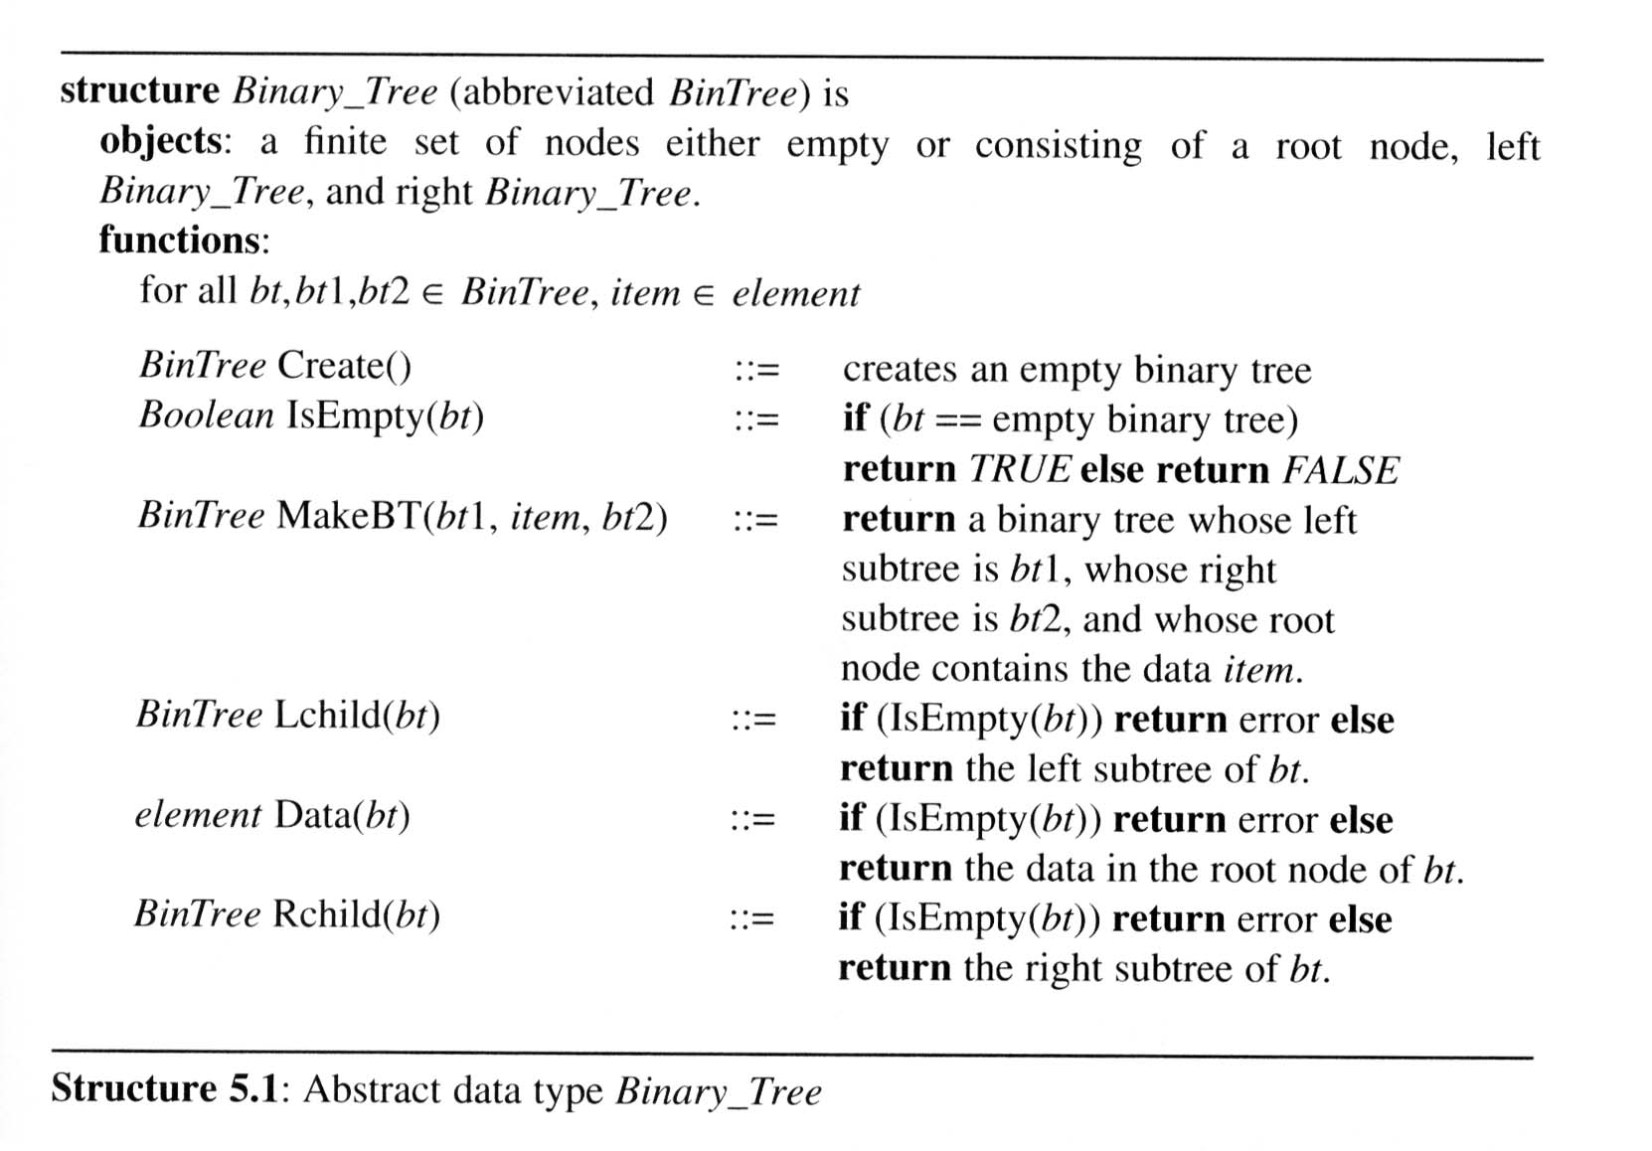
Binary Tree ADT

Slide 18
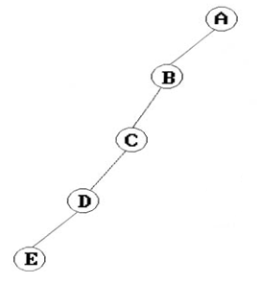
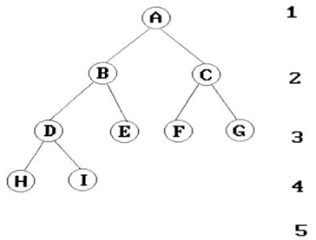
Special Binary Trees
skewed tree
Tree is slanted to one side, only one leaf node.
complete binary tree (of n levels)
Nodes up to level n-1 all exist (2^{n}-1 nodes)
Nodes at level n exist in order from left to right.

Slide 19
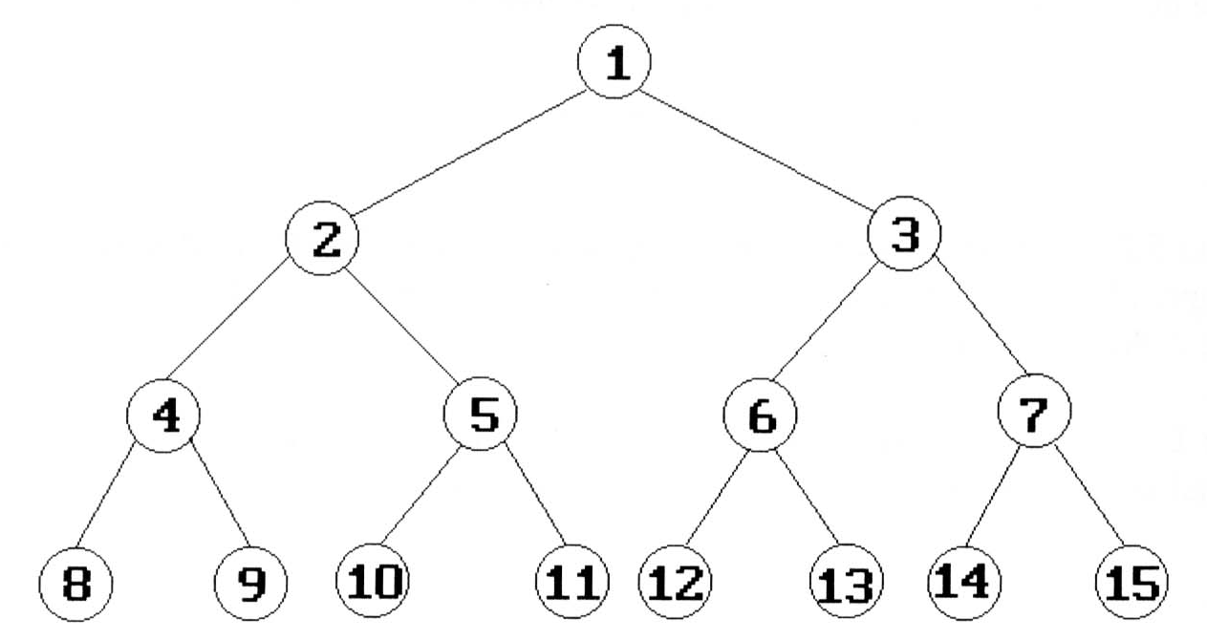
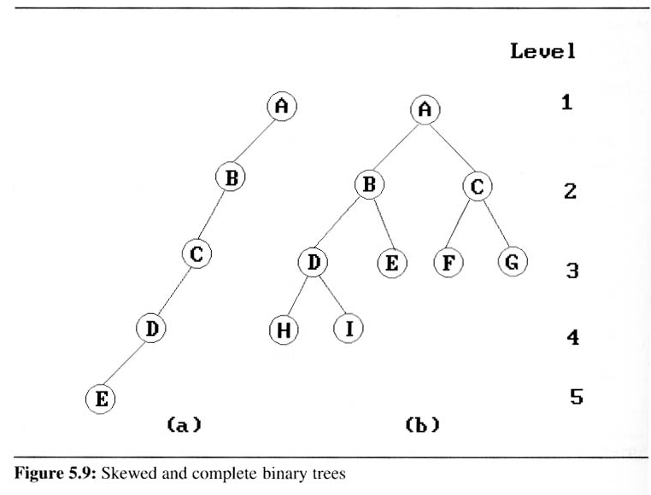
Complete Binary Tree
A full binary tree of depth k is a binary tree of depth k having
2^{k}-1 nodes, k > 0
A binary tree with n nodes and depth k is complete
iff its nodes correspond to the nodes numbered from 1 to n in the full binary tree of depth k
The height of a complete binary tree with n nodes: ?

Slide 20
Properties of Binary Trees
Lemma 5.1 [Maximum number of nodes]:
The maximum number of nodes on level i of a binary tree is
2^{i-1}, i >=1.
The maximum number of nodes in a binary tree of depth k is 2^{k}-1, k >=1.

Slide 21
Properties of Binary Trees
Lemma 5.2 [Relation between number of leaf nodes and degree-2 nodes]:
For any nonempty binary tree, T
n₀ is the number of leaf nodes
n₂ is the number of nodes of degree 2
then n₀ = n₂ + 1
Proof by induction
True for up to 3 nodes
Assume true for n nodes
Show true for n+1 nodes

Slide 22
Array Representation of B.T. (1)
Lemma 5.3: If a complete binary tree with n nodes is represented sequentially, then for any node with index i, 1 <= i <= n, we have
Parent(i) has index if i >=2.
LeftChild(i) has index 2i if 2i <= n.
RightChild(i) has index 2i+1 if 2i+1 <= n.
A
1
[1]
[2]
[3]
[4]
[5]
[6]
[7]
B
2
C
3
A B C — D — E
Level 1
D
E
Level 2
Level 3
4
5
6
7

Slide 23
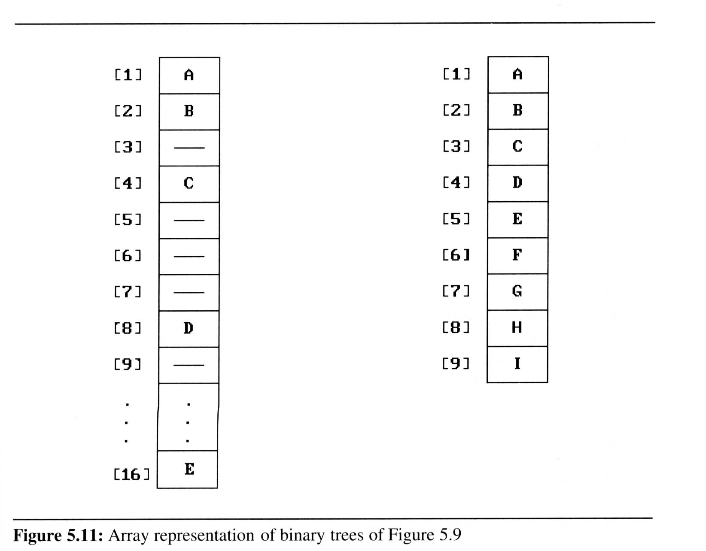
Array Representation of B.T. (2)
Waste spaces: in the worst case, a skewed tree of depth k requires 2^{k}-1 spaces. Only k spaces will be occupied
Hard to visualize
Insertion or deletion of nodes from the middle of a tree
requires the movement of potentially many nodes

Slide 24
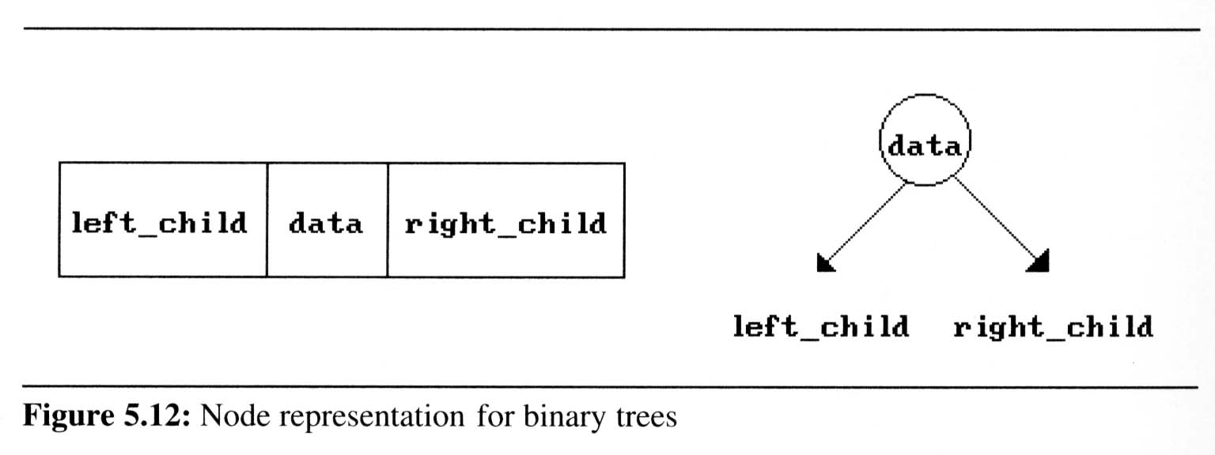
Linked List rep. of B.T. (1)
typedef struct node *tree_pointer;
typedef struct node {
int data;
treePointer leftChild, rightChild;
};
leftChild
rightChild
leftChild
rightChild

Slide 25
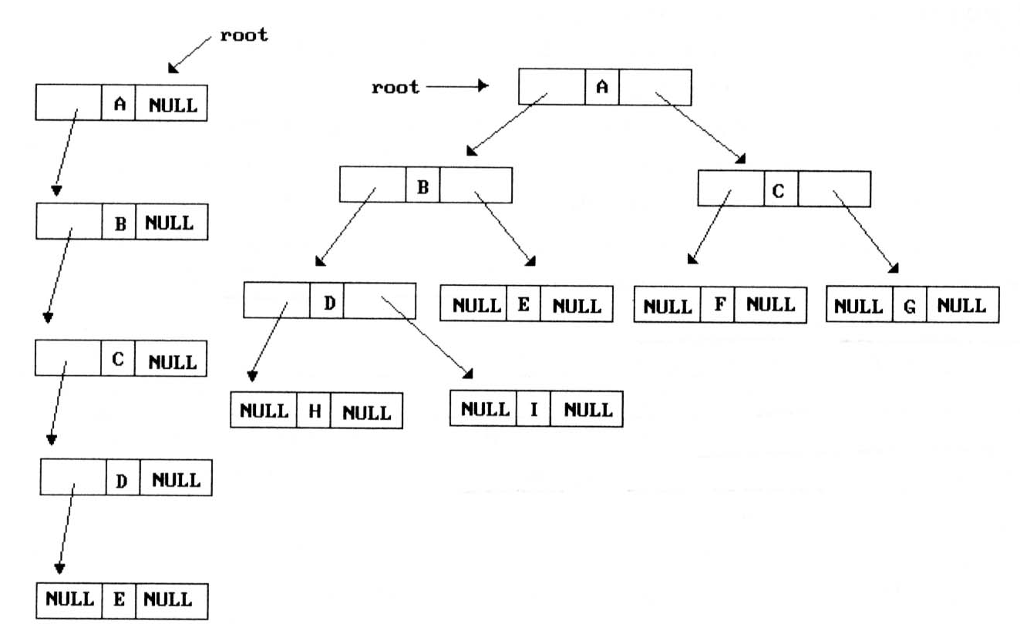
Examples: Linked List rep. of B.T.

Slide 26
Binary Tree Traversals

Slide 27
Traversal Orders
How to visit all nodes?
six possible combinations of traversal
LVR, LRV, VLR, VRL, RVL, RLV
If left before right, only 3 traversals remain
LVR (inorder), LRV (postorder), VLR (preorder)
left_child
data
right_child
V
visit
node
L: move left
R: move right

Slide 28
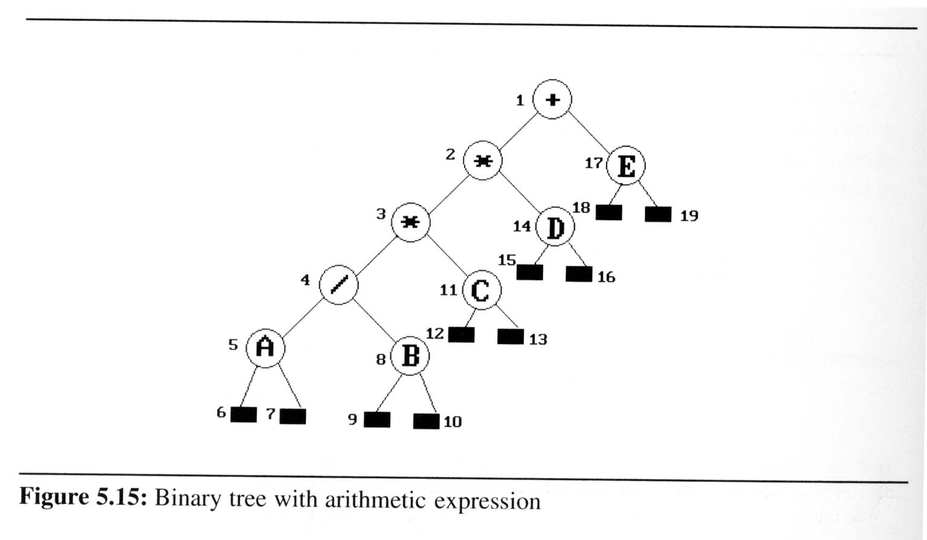
Arithmetic Expression as a B.T.
Represent arithmetic expression as a binary tree such that
inorder traversal (infix expression) yields
A / B * C * D + E
preorder traversal (prefix expression)
+ * * / A B C D E
postorder traversal (postfix expression)
A B / C * D * E +
level order traversal
+ * E * D / C A B

Slide 29
Inorder Traversal
LVR
Output:
A
/
B
*
C
*
D
+
E
void inorder (treePointer ptr)
{
if (ptr) {
inorder (ptr->leftChild);
printf (“%d”, ptr->data);
inorder (ptr->rightChild);
}
}
ptr
L
V
R

Slide 30
Preorder Traversal
VLR
Output:
+
*
*
/
A
B
C
D
E
void preorder (treePointer ptr)
{
if (ptr) {
printf (“%d”, ptr->data);
preorder (ptr->leftChild);
preorder (ptr->rightChild);
}
}

Slide 31
Postorder Traversal
LRV
Output:
A
B
/
C
*
D
*
E
+
void postorder (treePointer ptr)
{
if (ptr) {
postorder (ptr->leftChild);
postorder (ptr->rightChild);
printf (“%d”, ptr->data);
}
}

Slide 32
Iterative Inorder Traversal
use a stack to simulate recursion
void iterInorder (treePointer node)
{
int top = -1; /* init the stack */
treePointer stack[MAX_STACK_SIZE];
for (;;) {
for (; node; node=node->leftChild)
push (node); /* add to stack */
node=pop(); /* delete from stack */
if (!node) break; /* stack empty */
printf (“%d”, node->data);
node=node->rightChild;
}
}
5
4
8
11
3
14
2
17
1
A
/
B
*
C
*
D
+
E
L
V
R
output:
A
/
B
*
C
*
D
+
E
node

Slide 33
Analysis of iterInorder()
Let n be the number of nodes in the tree
Time complexity: O(n)
Every node of the tree is placed on and removed from the stack exactly once
Space complexity: O(n)
equal to the depth of the tree (skewed tree is the worst case)

Slide 34
Level-order Traversal
Algorithm:
visit the root first
then the root’s left child
followed by the root’s right child
visiting the nodes at each new level from the leftmost node to the rightmost nodes
Needs a queue to keep track of nodes at next level

Slide 35
Level-order Traversal
output:
+
*
E
*
D
/
C
A
B
void level_order (treePointer ptr)
{
int front = rear = 0;
tree_pointer queue[MAX_QUEUE_SIZE];
if (!ptr) return; /* empty tree */
addq (front, &rear, ptr);
for (;;) {
ptr = deleteq (&front, rear);
if (ptr) {
printf (“%d”, ptr->data);
if (ptr->leftChild);
addq (front, &rear, ptr->leftChild);
if (ptr->rightChild);
addq (front, &rear, ptr->rightChild);
}
else break;
}
}
1
2
17
3
14
4
11
5
8
+
*
E
*
D
/
C
A
B
FIFO
ptr

Slide 36
Additional Binary Tree Operations

Slide 37
Copying Binary Trees
modify the postorder traversal algorithm slightly to copy the binary tree
treePointer copy (treePointer original)
{
treePoiner temp;
if (original) {
MALLOC (temp, sizeof (*temp));
temp->leftChild = copy (original->leftChild);
temp->rightChild = copy (original->rightChild);
temp->data = original->data;
return temp;
}
return NULL;
}

Slide 38
Testing for Equivalent Trees
Binary trees are equivalent
if they have the same topology and the information in corresponding nodes is identical
V
L
R
int equal (treePointer first, treePointer second)
{ 兩者皆為空
return ( (!first && !second) ||
(first && second 兩者皆不為空 &&
(first->data == second->data) &&
equal (first->leftChild, second->leftChild) &&
equal (first->rightChild, second->rightChild) )

Slide 39
Propositional Calculus Expression
Boolean Variables: x₁, x₂, …, x_{n} : true or false only
Logical Operators: ∧(and), ∨(or), ¬(not)
Propositional Calculus Expression
A variable is an expression
If x and y are expressions, then ¬x, x ∧ y, x ∨ y are expressions
Parentheses can be used to alter the normal order of evaluation (default: ¬ > ∧ > ∨)
Example: x₁ ∧ (x₂ ∨ ¬x₃)

Slide 40
B.T. rep. of Propositional Calculus Exp.
(x₁ ∧ ¬x₂) ∨ (¬ x₁ ∧ x₃) ∨ ¬x₃
∨
∨
¬
∧
∧
X₃
X₁
¬
¬
X₃
X₂
X₁

Slide 41
Satisfiability Problem
Satisfiability problem:
Is there an assignment to make an expression true?
Solution for the Example x₁ ∨ (x₂ ∧ ¬x₃) :
If x₁ and x₃ are false and x₂ is true
false ∨ (true ∧ ¬false) = false ∨ true = true
For an expression with n variables
there are ? possible combinations of true and false

Slide 42
B.T. rep. of Propositional Calculus Exp.
(x₁ ∧ ¬x₂) ∨ (¬ x₁ ∧ x₃) ∨ ¬x₃
Use Postorder Traversal (LRV) to evaluate the expression
∨
∨
¬
∧
∧
X₃
X₁
¬
¬
X₃
X₂
X₁

Slide 43
Node Structure for Satisfiability Problem
assume each node has four fields:
leftChild | data | value | rightChild
typedef enum {not, and, or, true, false} logical;
typedef struct node *treePointer;
typedef struct node {
treePointer leftChild;
logical data;
short int value;
treePointer rightChild;
};

Slide 44
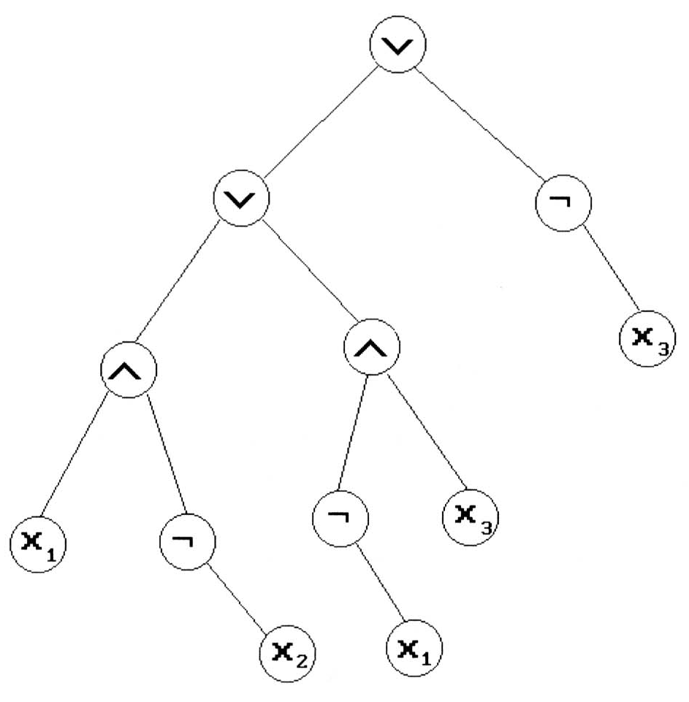
Evaluating the Satisfiability B.T.
Void postOrderEval(treePointer node)
{
if (node) {
postOrderEval(node->leftChild);
postOrderEval(node->rightChild);
switch(node->data) {
case not: node->value =
!node->rightChild->value;
break;
case and: node->value =
node->rightChild->value &&
node->leftChild->value;
break;
case or: node->value =
node->rightChild->value ||
node->leftChild->value;
break;
case true: node->value = TRUE;
break;
case false: node->value = FALSE;
} } }
node
TRUE
L
R
V
TRUE
FALSE
FALSE
T
TRUE
TRUE
T
F
TRUE
FALSE
FALSE
TRUE
F
T
FALSE
TRUE

